Slide 1
Chapter: 7.2
Determining concentration

Slide 2
The concentration of a solution is the amount of solute present in a specified amount of solution.
Molarity
The molarity of a solution is defined as the number of moles of solute per litre of solution.
The concentration of a particular solution is given by

Slide 3

Concentration $\left(mL^{−1}\right)=number$ of moles of solute (mol)÷ volume of solution (L)
c= n/V
See worked example: 7.2 in page: 313

Slide 4
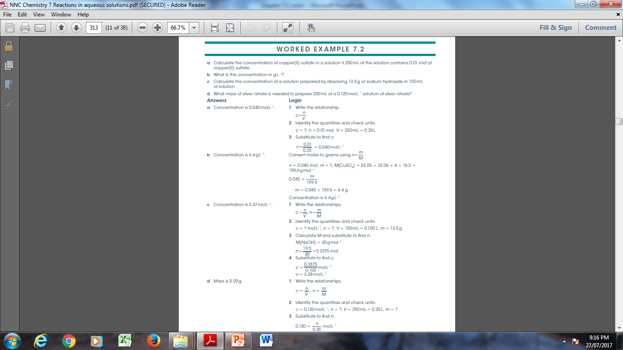

Slide 5
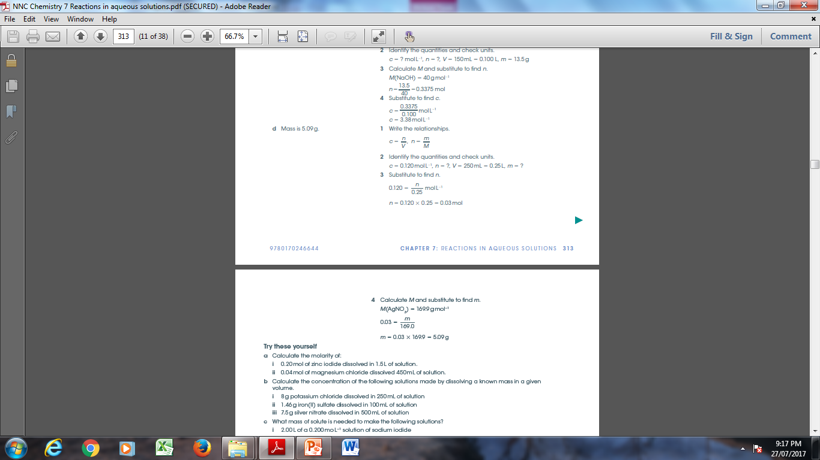

Slide 6
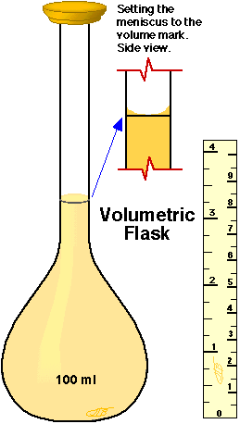
Laboratory preparation of a solution
To prepare a solution of known concentration, chemists must use precise apparatus. A volumetric flask is used to allow precise volume determinations.

Slide 7
https://www.youtube.com/watch?v=7qVTsn_qGLU

Slide 8
The steps for preparing a solution of known concentration are as follows
1. The required amount of solute is weighed and then transferred to a volumetric flask of required volume.
2. The beaker that contained the solute is rinsed with distilled water and the rinsed water is transferred to the volumetric flask
3. More water is added to dissolve the solute and then up to the calibration mark.
4. The stopper is placed in the flask, which is inverted several times to ensure thorough mixing of the solution.

Slide 9
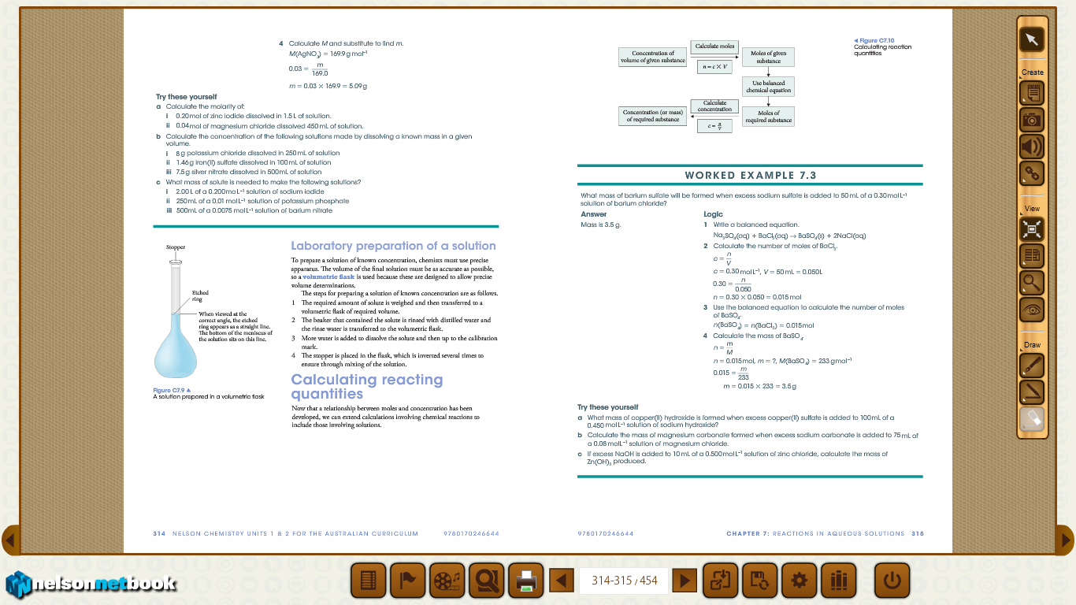
Calculating reacting quantities

Slide 10
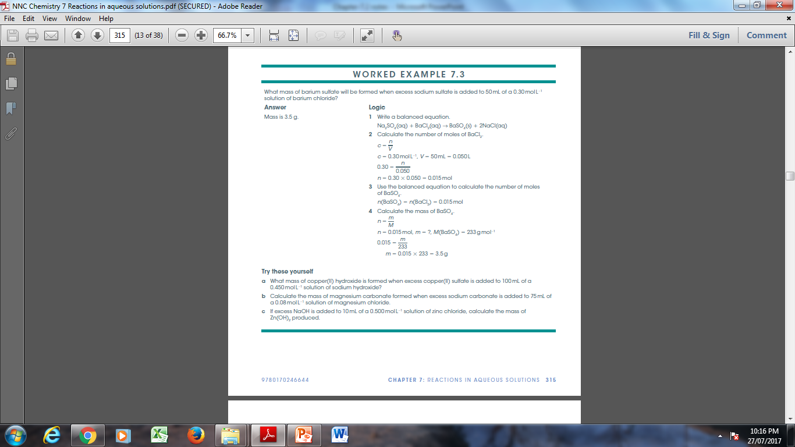

Slide 11
Do Question set: 7.2 NC Page: 316---- Q’s : 1, 2 (a,b), 3(a), 5( b) 6( a) and 7

